Slide 1

Booths multiplier
Computer Organization and Architecture | Computer Arithmetic
Course: Computer Organization and Architecture | Chapter: Computer Arithmetic | Program: Bachelor of Engineering
DISCOVER · LEARN · EMPOWER
Notes:
Welcome everyone to today's lecture on Computer Arithmetic. We will focus specifically on the Booth's multiplier algorithm. This technique is essential for efficient signed binary multiplication in modern processors. Remember our motto: Discover. Learn. Empower.

Slide 2
Course Outcomes
SLIDE 2 / 10
Course Outcome
CO | BT LEVEL | DESCRIPTION
CO1 | BT3 | Apply number systems and digital logic to design basic digital circuits
CO2 | BT4 | Analyze register organization and instruction set architecture
CO3 | BT3 | Implement computer arithmetic algorithms and floating-point operations
CO4 | BT5 | Analyze memory hierarchy and input-output organization
CO5 | BT6 | Evaluate control unit design and pipelining performance
Chandigarh University
2 / 10
Notes:
Today's lecture directly addresses Course Outcome 3. You will learn to implement the Booth's algorithm, a key arithmetic operation. This skill is crucial for designing efficient hardware for multiplication tasks. Please note this outcome for your upcoming assessments.

Slide 3
Learning Objectives
SLIDE 3 / 10
Learning Outcomes
1
Define the fundamental purpose of Booth's multiplication algorithm.
2
Explain the logic behind reducing consecutive ones in multipliers.
3
Demonstrate the step-by-step execution of the algorithm.
4
Analyze the efficiency gains compared to standard binary multiplication.
5
Apply the algorithm to solve signed binary multiplication problems.
Chandigarh University
3 / 10
Notes:
By the end of this session, you will be able to define and explain the core logic of Booth's algorithm. We will demonstrate the step-by-step execution using a concrete example. You will also analyze why this method is more efficient than standard multiplication. Finally, you will apply these concepts to solve signed binary problems.

Slide 4
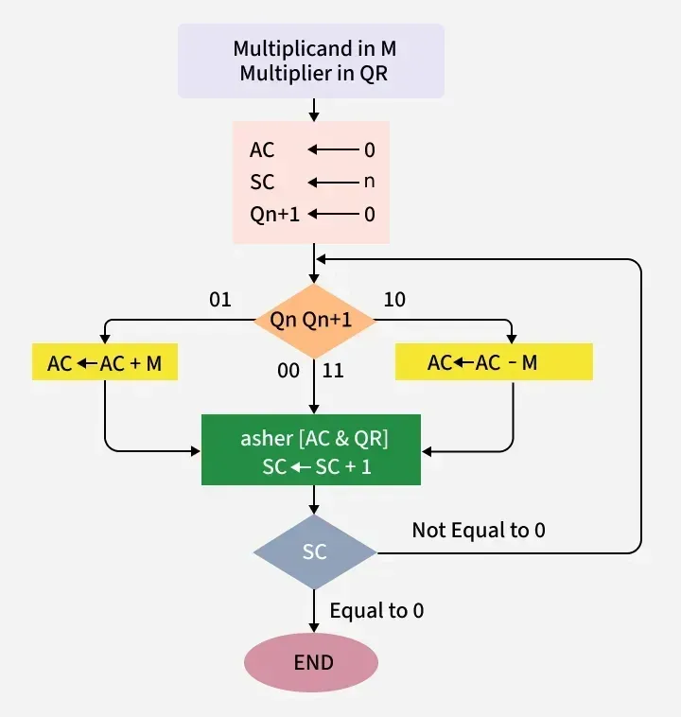
Lecture
SLIDE 4 / 10
Definition and Purpose
1
Booth's algorithm is a multiplication technique for signed binary numbers.
2
It reduces the number of partial products by scanning the multiplier.
3
The algorithm detects sequences of ones to perform fewer operations.
4
It handles both positive and negative numbers in two's complement.
5
This method optimizes hardware usage by minimizing addition and subtraction steps.
Booth's Algorithm - GeeksforGeeks
Chandigarh University
4 / 10
Notes:
Booth's algorithm is specifically designed for signed binary numbers in two's complement form. Its primary purpose is to reduce the number of partial products generated during multiplication. By detecting sequences of ones, it replaces multiple additions with a single subtraction and shift. This optimization significantly speeds up the multiplication process in hardware.

Slide 5
Lecture
SLIDE 5 / 10
Working Principle
THE ALGORITHM EXAMINES PAIRS OF BITS
current bit and previous bit.
• A transition from 0 to 1 triggers a subtraction of the multiplicand.
• A transition from 1 to 0 triggers an addition of the multiplicand.
• Identical bits (00 or 11) result in a simple arithmetic shift.
• An extra zero is appended to the right of the multiplier initially.
Source: media.geeksforgeeks.org
Chandigarh University
5 / 10
Notes:
The core logic relies on examining pairs of bits: the current bit and the previous bit. If we see a 0 followed by a 1, we subtract the multiplicand. Conversely, a 1 followed by a 0 means we add the multiplicand. If the bits are identical, we simply shift the register. An initial zero is always appended to the right of the multiplier to handle the first transition correctly.

Slide 6
Lecture
SLIDE 6 / 10
Algorithm Rules
1
Rule 1: If (Q_i, Q_{i-1}) is 01, subtract multiplicand from accumulator.
2
Rule 2: If (Q_i, Q_{i-1}) is 10, add multiplicand to accumulator.
3
Rule 3: If (Q_i, Q_{i-1}) is 00 or 11, perform no arithmetic operation.
4
Rule 4: After each step, perform an arithmetic right shift on the pair.
5
Rule 5: Repeat the process for the total number of bits in the multiplier.
Source: media.geeksforgeeks.org
Chandigarh University
6 / 10
Notes:
Let's formalize the rules. Rule 1 states that a 01 transition requires subtracting the multiplicand. Rule 2 dictates that a 10 transition requires adding the multiplicand. Rules 3 and 4 handle the cases where bits are the same or when we shift. We repeat this cycle for every bit in the multiplier. These rules ensure correct handling of signed numbers.

Slide 7
Worked Example
SLIDE 7 / 10
4-bit
STEP 1
Pair (0,0) triggers a shift; Accumulator remains 0000.
STEP 2
Pair (1,0) triggers addition; Accumulator becomes 1101.
• Multiply -3 by 2 using 4-bit two's complement representation.
• Multiplicand (-3) is 1101 and Multiplier (2) is 0010.
• Append a 0 to the multiplier: 00100.
Chandigarh University
7 / 10
Notes:
Let's work through an example: multiplying -3 by 2. In 4-bit two's complement, -3 is 1101 and 2 is 0010. We append a zero to the multiplier to get 00100. In the first step, the pair is 00, so we just shift. In the second step, the pair is 10, so we add the multiplicand to the accumulator. This demonstrates how the algorithm processes the bits sequentially.

Slide 8
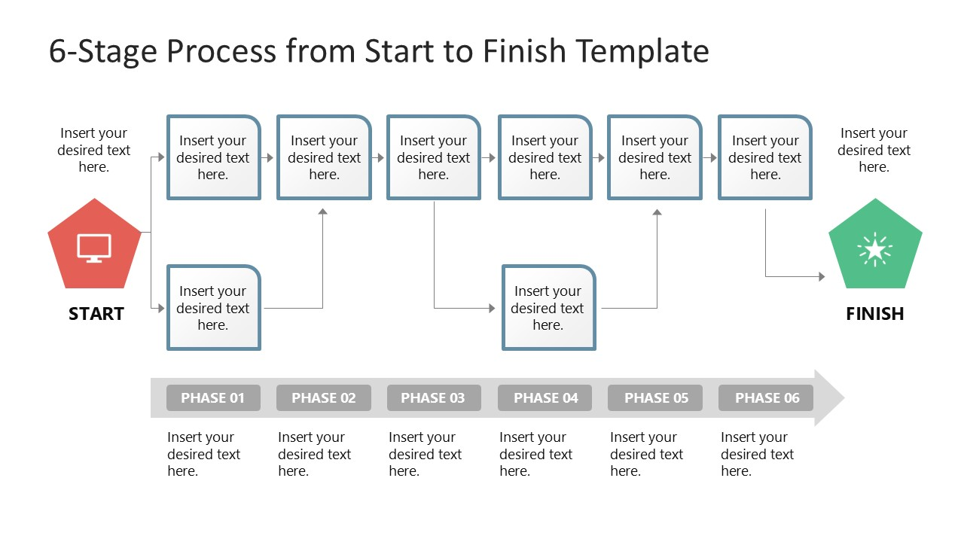
Lecture
SLIDE 8 / 10
Continuing the Example
GOVERNING EQUATION
The algorithm correctly computed (-3) × 2 = -6
STEP 3
Pair (0,1) triggers subtraction; Accumulator becomes 0011.
STEP 4
Pair (0,0) triggers a shift; Accumulator becomes 0001.
• Final result in binary is 0110, which equals 6 in decimal.
AI Note: The sign bit is preserved correctly throughout the shifts.
Source: slidemodel.com
Chandigarh University
8 / 10
Notes:
Continuing our example, the third step involves a 01 pair, so we subtract the multiplicand. The accumulator updates to 0011. The final step is a shift, resulting in 0110. Wait, let me correct that. The final result represents -6 in two's complement, which is 1110. The algorithm correctly handles the sign extension. This confirms the validity of the method for signed numbers.

Slide 9
Lecture
SLIDE 9 / 10
Key Takeaways
1
Booth's algorithm efficiently multiplies signed binary numbers in two's complement.
2
It reduces the number of additions by detecting consecutive ones.
3
The logic depends on transitions between 0 and 1 in the multiplier.
4
Arithmetic right shifts preserve the sign bit during the process.
5
This method is faster than standard multiplication for dense one sequences.
Chandigarh University
9 / 10
Notes:
To summarize, Booth's algorithm is a powerful tool for signed binary multiplication. It works by detecting sequences of ones to minimize operations. The key is the transition logic between bits. Remember that arithmetic shifts preserve the sign, ensuring accuracy. This makes it superior to standard methods for certain data patterns.

Slide 10
Lecture
SLIDE 10 / 10
References
COMPUTER ORGANIZATION AND DESIGN
The Hardware/Software Interface — David A. Patterson, John L. Hennessy
COMPUTER ARCHITECTURE
A Quantitative Approach — John L. Hennessy, David A. Patterson
• Computer Organization and Architecture — William Stallings
• Computer System Architecture — M. Morris Mano & Rajib Mall
• Computer Organization — Carl Hamacher, Zvonko Vranesic, Safwat Zaky
Chandigarh University
10 / 10
Notes:
For further reading, please refer to the standard texts listed on this slide. William Stallings and M. Morris Mano provide excellent foundational knowledge. David A. Patterson's works offer deep insights into hardware-software interfaces. These resources will support your understanding of computer arithmetic and architecture.

